Slide 1
Research Ethics
Pravin kumar
Professor, Dept. of Mechanical Engineering
Delhi Technological University

Slide 2
Objectives
Provide overview major ethical topics in Responsible Conduct of Research (RCR)
Discuss legal obligations – federal regulations
Raise awareness of procedures and guidelines designed to support the responsible and ethical conduct of research at the University

Slide 3
Research Ethics
Ethics may be defined as:
❑Sets of moral principles or norms that are used to guide moral choices of behaviour and relationships with others. (Blumberg, et al, 2005)
❑The moral principles and actions guiding and shaping research. (ESRC, 2004)
Ethics in research - - The set of values, standards, and principles used to distinguish between appropriate and acceptable conduct and unacceptable conduct at all stages of the research process

Slide 4
Foundation of Shared Values
TRUST— Core ethical value in the scientific pursuit of the truth
HONESTY — Conveying information truthfully and honoring commitments
ACCURACY— Reporting findings precisely and taking care to avoid errors
OBJECTIVITY— Letting the facts speak for themselves and avoiding bias

Slide 5
Research Misconduct
Department of Health and Human Services defines research misconduct as:
Fabrication – making up results and recording or reporting them.
Falsification – manipulating research materials, equipment or processes or changing or omitting results such that the research is not accurately represented.
Plagiarism – appropriating someone else’s ideas, processes, results or words without giving proper credit.
Deliberate or repeated non-compliance with the regulations can be considered misconduct.

Slide 6
A Closer Look at Plagiarism
Appropriation means using or taking something that is not yours
Plagiarism is using another person’s words or ideas without proper attribution
Plagiarism is academically dishonest because faculty, scholars, and students are expected to do original work

Slide 7
Understanding the Definition (cont’d)
Processes … adopting or using research methods described by another investigator, especially when the research method is not common knowledge
Results … using or reporting data, figures, or tables that represent another investigator’s research results

Slide 8
Understanding the Definition (cont’d)
Plagiarism means taking or using any of the following intellectual property without permission or giving credit:
Words … rearranging phrases, copying a string of consecutive words, or paraphrasing extensively
Ideas … using original information learned from confidential reviews, conference presentations, etc

Slide 9
Preventing Plagiarism
Understand the difference between “common knowledge” and “original” ideas
Do the right thing
❑ Give credit, mark direct quotations, and use reference citations –use disciplinary standards!
❑ Follow your conscience

Slide 10
Research Misconduct in Biomedical & Social Behavioral Research
Behaviors that are considered research misconduct:
Falsifications:
Substitutions of one subject’s record for another’s
Changing research record to favor the study’s hypothesis
Altering eligibility dates and eligibility test results
Falsifying dates on subject screening logs
Fabrications:
Not conducting interviews with subjects and creating records of the interview
Making up subjects visits/interviews and inserting that record into the study data
Recording the results of follow-up visits/interviews with deceased subjects

Slide 11
Types of data that have been falsified or fabricated in clinical studies
Interviews
Entry criteria
Screening logs
Approval forms
Follow-up exams/data
Consent forms
Test scores
Laboratory results
Patient data
Number of subjects
Dates of procedures
Protocol
Study results

Slide 12
Criteria for Research Misconduct
Demonstrates a significant departure from accepted practices
Has been committed intentionally, or knowingly, or recklessly; and
Can be proven by a preponderance of evidence

Slide 13
What is NOT Misconduct
1. honest, unintentional error
2. honest differences of opinion

Slide 14
Nuremberg Code 1947
Voluntary consent of the human subject is essential
Experiment should yield fruitful results for the good of society, unprocurable by other methods or means of study, and not random and unnecessary in nature
Experiment should be so designed on a knowledge of the problem under study that the anticipated results will justify the performance of the experiment.
Experiment should be so conducted as to avoid all unnecessary physical and mental suffering and injury
No experiment should be conducted where there is an a priori reason to believe that death or disabling injury will occur

Slide 15
The Belmont Report 1979 (Human Protection)
Respect for Persons (“Be courteous”)
Allow informed choice where participants can choose for themselves.
Provide additional protections for those who need it.
Derived concepts: Informed consent, Respect for privacy
Beneficence (“Do good”)
We are obligated to protect persons from harm by clearly identifying and maximizing anticipated benefits while minimizing possible risks of harm.
Derived concepts: Good research design, Competent investigators, Favorable risk/benefit analysis.
Justice (“Be fair.”)
Requires that the benefits and burdens of research be distributed fairly.
Derived concepts: Equitable selection of subjects.

Slide 16
The Consent Process
The basic elements of the consent process include:
⚫ full disclosure of the nature of the research and the subject’s participation
⚫ adequate comprehension on the part of the potential subjects
⚫ the subject’s voluntary choice to participate

Slide 17
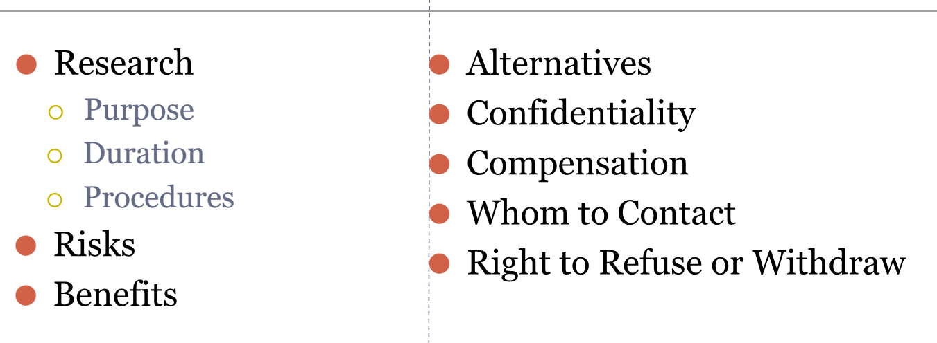
Basic Elements of Consent

Slide 18
Ethics & Animal Subjects Research-Why are animals used in research?
● Living organisms with complex anatomic systems may respond differently to chemical or biological entities than simple, single celled organisms
● Current regulatory guidelines require the use of animals for testing unless there is an approved alternative
● Some basic research can’t be done by bio-chemical experiments!
● Some advanced skills can’t be taught using non-animal models/dummies

Slide 19
Non-animal alternatives must be used, when reasonable and available
● Legislation led to organizations looking for alternatives to animal testing
● The 1993 Revitalization Act charged the National Institutes of Health (NIH) with developing research methods that do not require animals, that reduce the number of animals used, and that produce less pain and distress in animals
● Interagency Coordinating Committee on the Validation of Alternative Methods (ICCVAM) was formed

Slide 20
Covered Species
● Living or dead animal which is:
● Dog, Cat, Non-human Primate, Guinea pig, Hamster, Rabbit, Rodents or any other warm-blooded animal used for, or intended for use in research, teaching, testing, experimentation, or exhibition, or as a pet except
o birds bred for use in research
o Cold-blooded vertebrates

Slide 21
What are the “3 R’s” ?
❑ Reduction:
o Reduce the number of animals used
o Use enough to make the data valid
❑ Refinement:
o Refine techniques and procedures to reduce pain and distress
❑ Replacement:
o Replace animals with non-animal techniques or a lower species

Slide 22
Thanks

